Slide 1
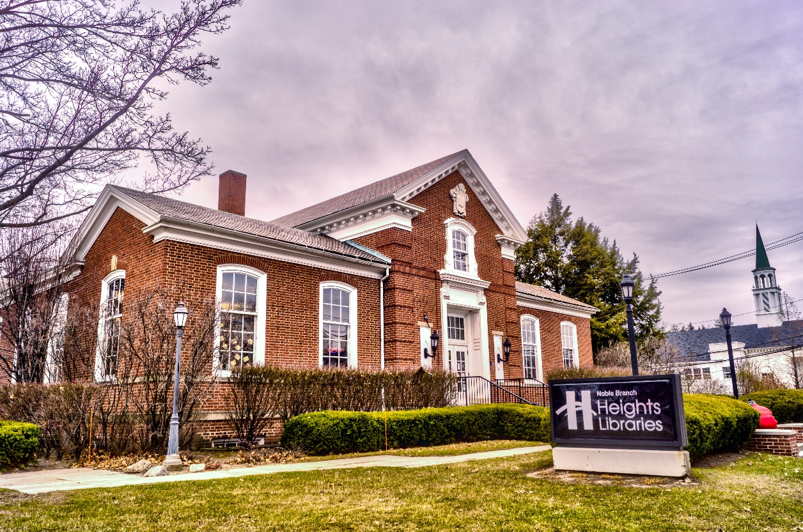
Noble Branch Survey Results
Winter 2021

Slide 2
Agenda for tonight
Introductions-Q & A instructions only, we are recording this presentation
Constance Dickerson, Branch Manager
Poll
Powerpoint
Next steps
Q & A

Slide 3
Noble Branch in CH city

Slide 4
Survey received 468 responses

Slide 5
Survey
How did you use the branch pre-COVID?
Checking out materials – 308 (66%)
Reading/browsing – 220 (47%)
Attending adult programs – 84 (18%)
Attending kids or teen programs – 47 (10%)
Attending baby/toddler/preschool programs – 30 (6%)
Using the computers – 113 (24%)
Doing research or writing – 61 (13%)
Relaxing/spending time someplace other than home – 112 (24%)

Slide 6
Responses indicate we need more space

Slide 7
Need separate spaces for early childhood, school age, and teens
Important place for children of Noble, Oxford, and Monticello schools, home-schooled
Computers too
Refugee hub/ESL

Slide 8
Comment specifics
Great staff
Heart of neighborhood
Outdoor space to sit
More computers
Age appropriate service areas
More programs needed
Classroom (ESL)
Business support
Accessibility-without stairs/elevator
Can we have a drive up book pick-up?

Slide 9
Concerns from comments
Taxes
Lose hub of neighborhood -don’t close
Lose warm cozy
Behavior
Noise-separate quiet space
Computers
Need more books
Not enough parking

Slide 10
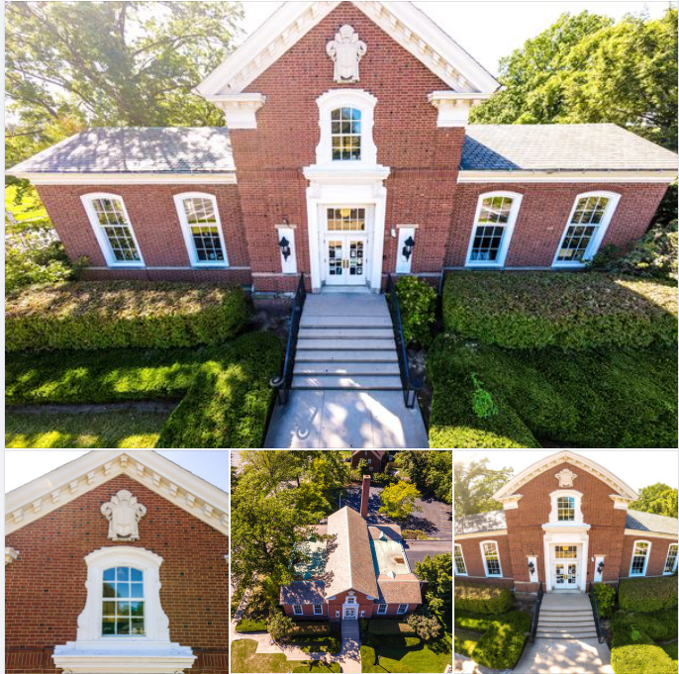
Keep historic character
Built in 1937, designed by Walker and Weeks
Warm, cozy

Slide 11
Currently have money saved
No new taxes needed
Building and Repair Fund
More space=more staff but we are very efficient.

Slide 12
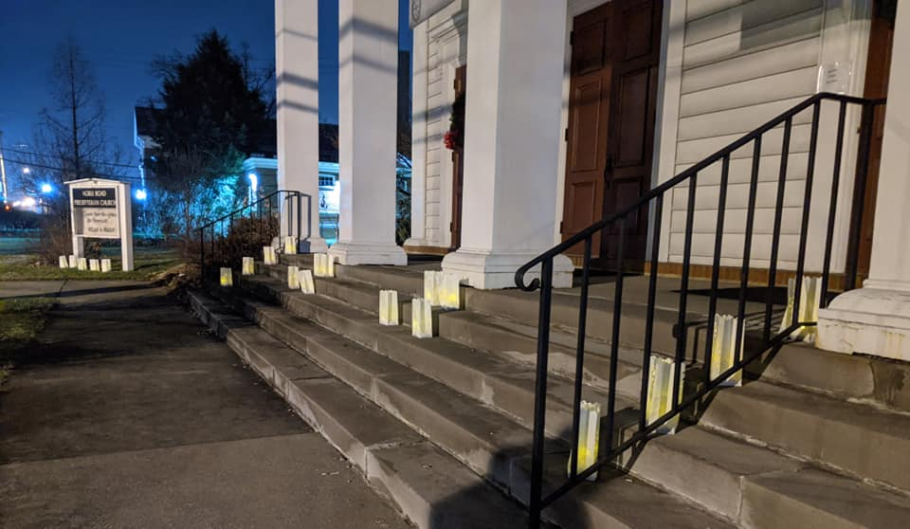
“Under Contract”

Slide 13
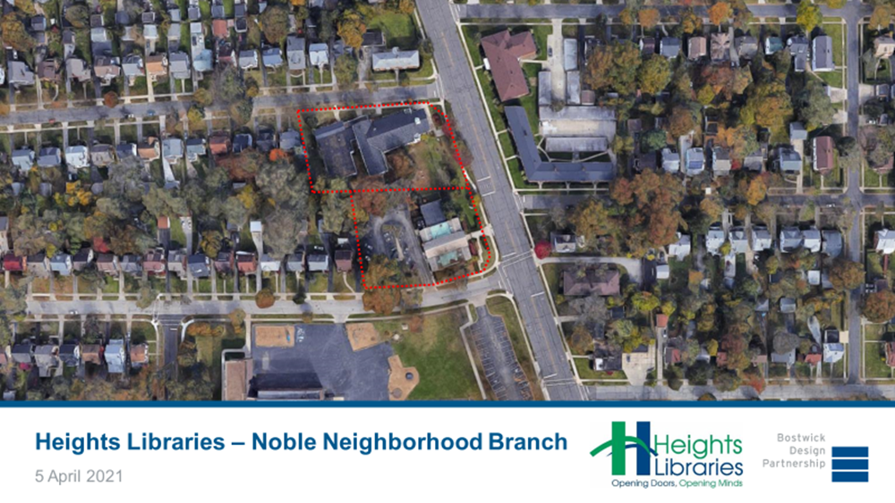

Slide 14
Bostwick Design Partnership
Rick Ortmeyer
CH Resident
Former Library Board Member

Slide 15
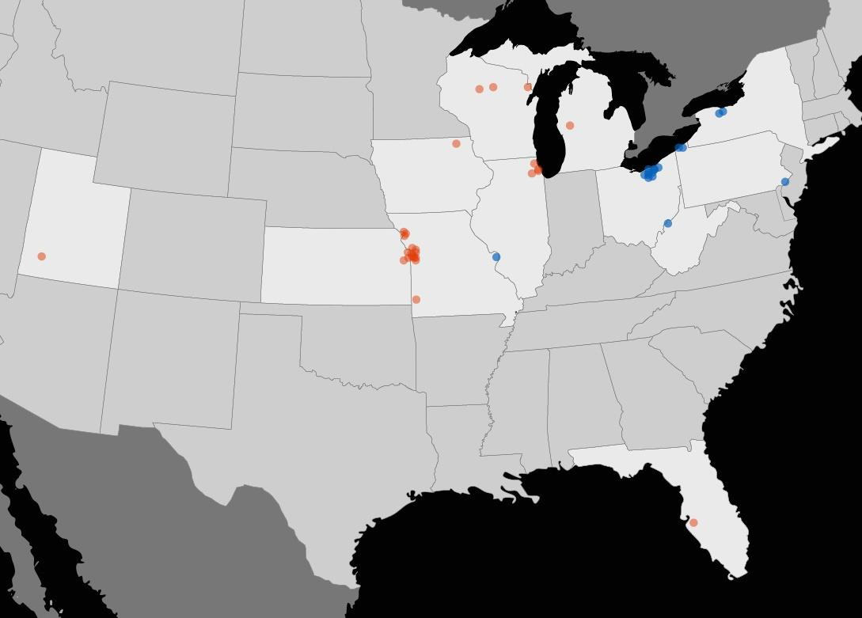
Public Libraries
68 Total Projects
42 with Bostwick
20 Historic
26 Years
12 States
Bostwick Design projects
Rick’s work prior to joining Bostwick Design
Notes:
42 projects with Bostwick

Slide 16
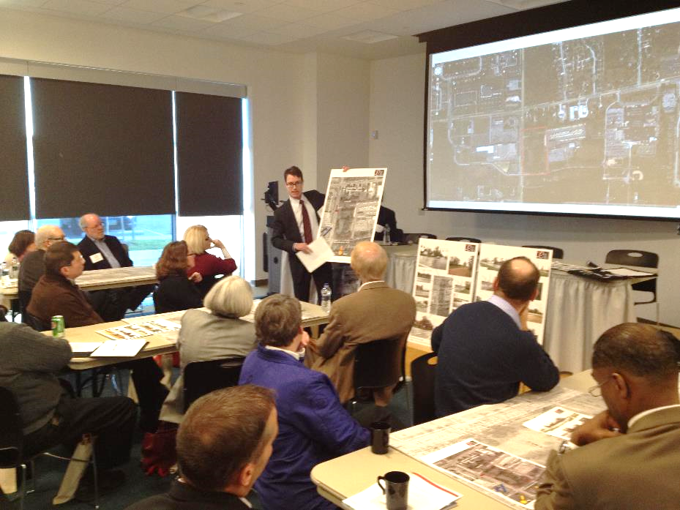
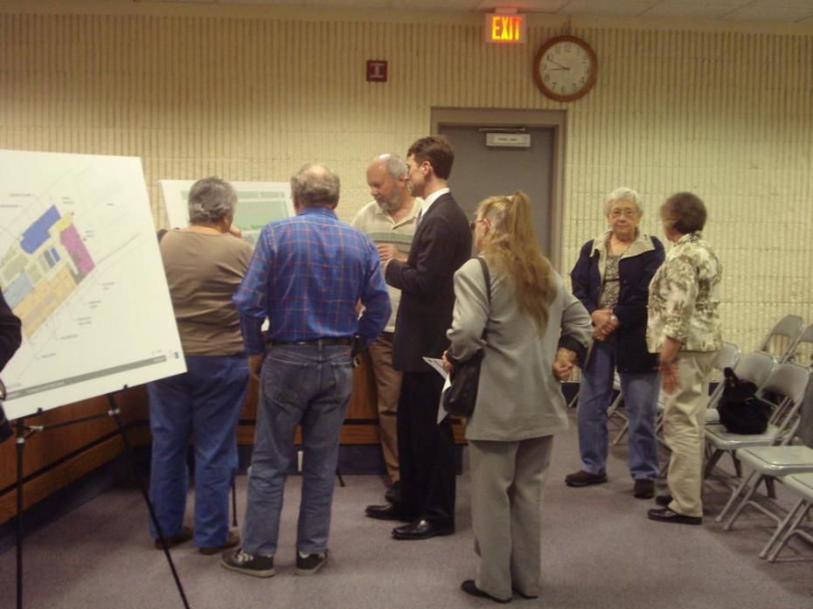
Gain Community Input

Slide 17
Develop the Ideal Noble Branch Program
TEENS
Public
Quieter
ADULTS
MAKE
CHILDREN
TECH
Drive Up?
NEW
SERVICE
MEETING
WORK &
STORAGE
Staff Entry
Deliveries
CAFE
Louder
STAFF
ENTRY
Private
Materials
Drop-off

Slide 18
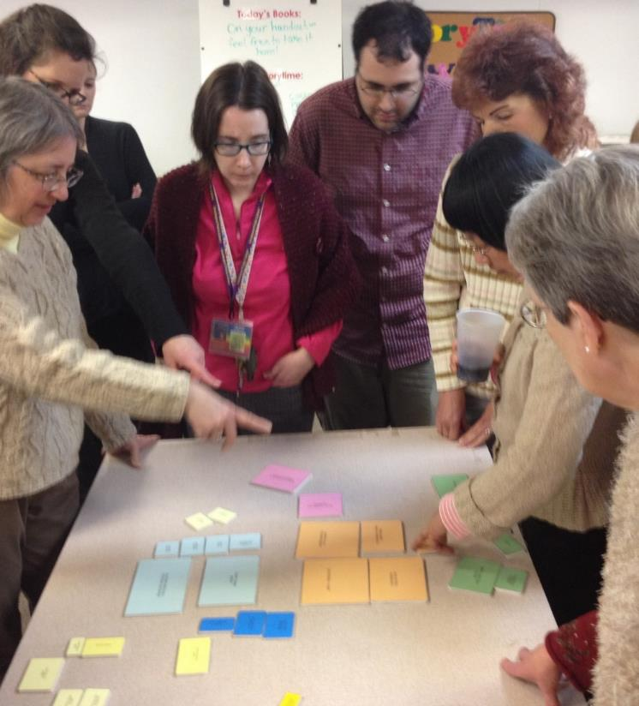
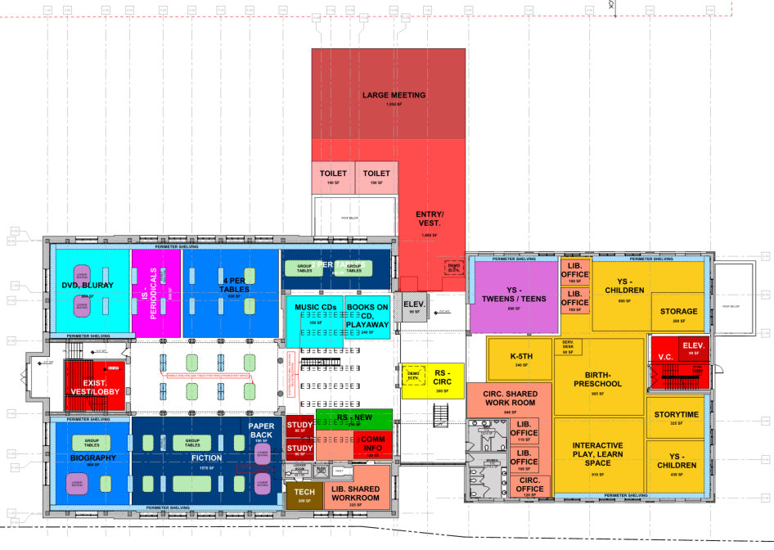
Create Planning Options

Slide 19
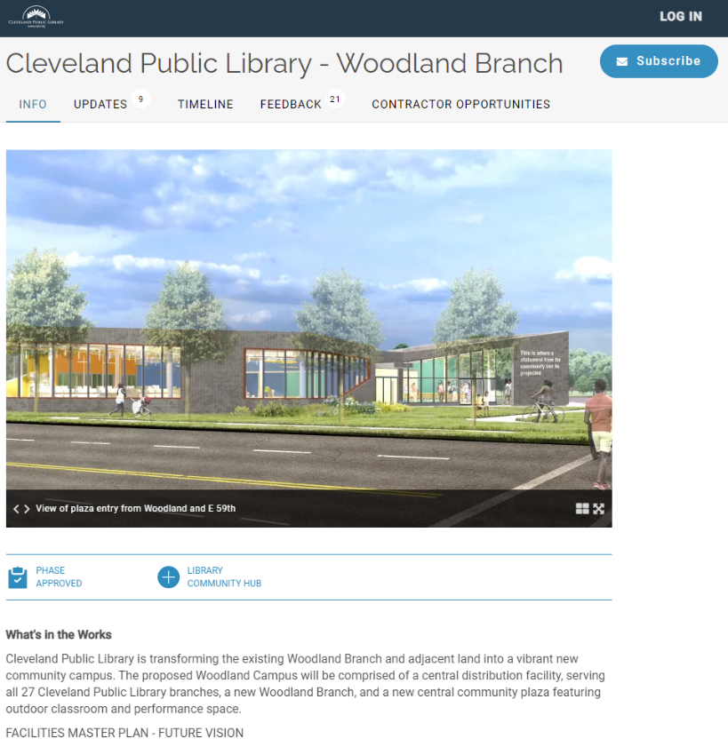
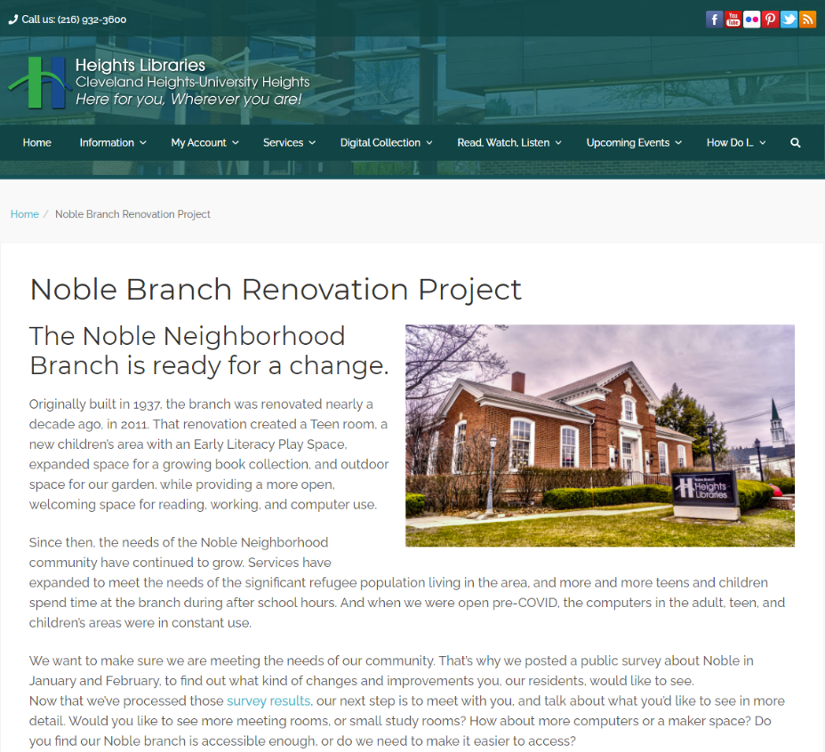
Prepare and Present Final Recommendations

Slide 20
Neighborhood-Noble Corridor
Very important to keep Noble Road vibrant
North of Mayfield needs computer access
Walkable
Economic Development
Meeting/gathering indoors and out
Placemaking

Slide 21
Future Heights study
See 91 page study from Future Heights
http://www.futureheights.org/programs/planning-and-development/noble-road-corridor-planning-project/

Slide 22
Recommendations from Noble Corridor study
Civic Life-a place for people
Attractive, enticing, vital
Serve all ages
Meeting, voting, learning, celebrating, growing

Slide 23
Now what?
Library will keep listening
Stop by Noble Neighborhood branch or watch library website for new information
Next step: Visioning with community
Any questions?
Contact: director@heightslibrary.org

